Slide 1
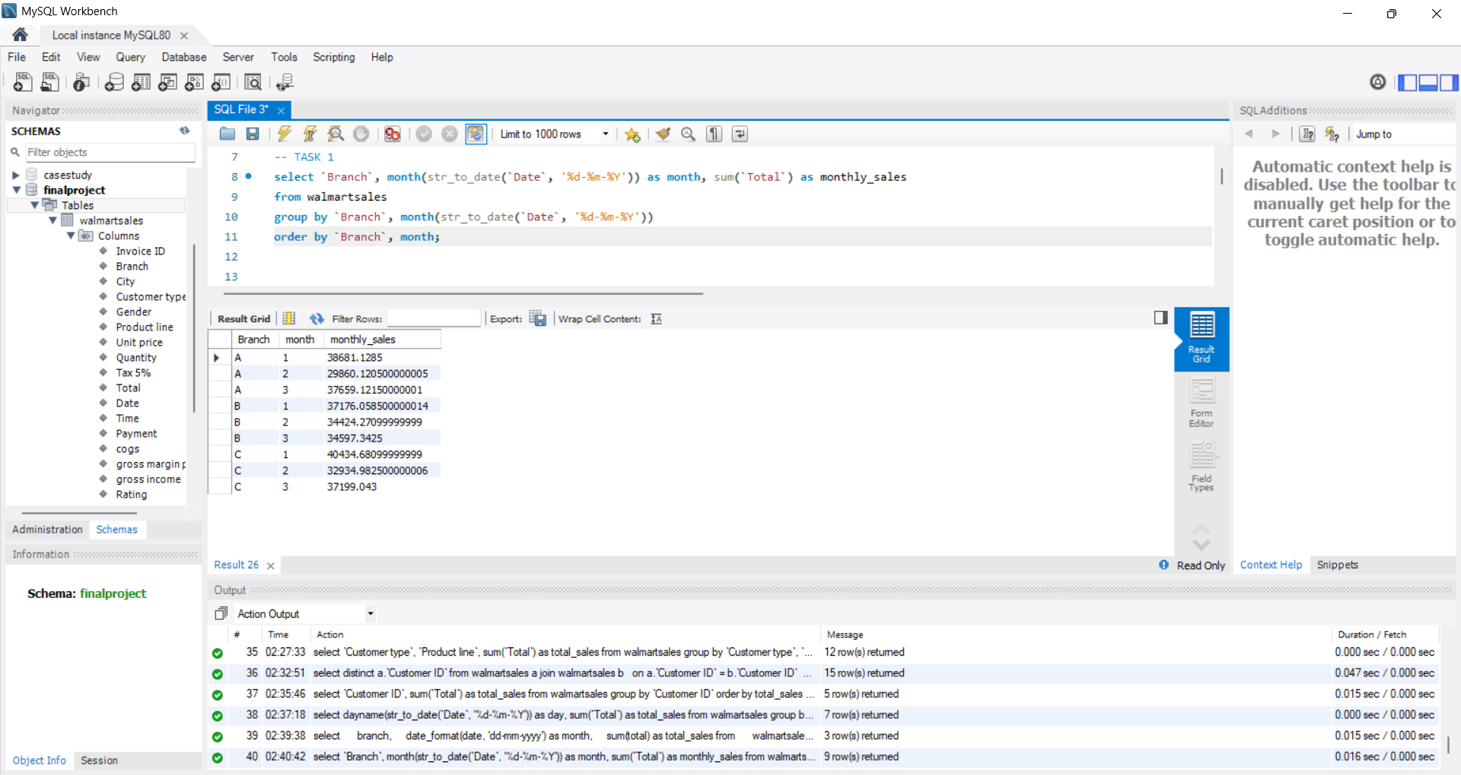
Task 1: Identifying the Top Branch by Sales Growth Rate
select branch, date_format(date, 'dd-mm-yyyy') as month, sum(total) as total_sales from walmartsales group by branch, month order by branch, month;

Slide 2
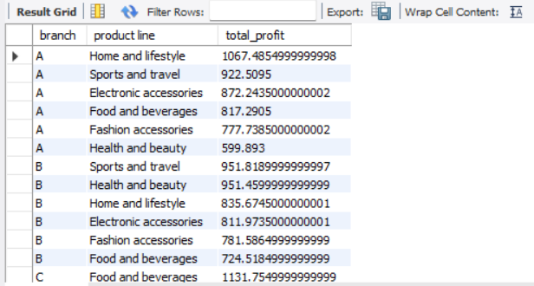
Task 2: Finding the Most Profitable Product Line for Each Branch
select branch, `product line`, sum(`gross income`) as total_profit from walmartsales group by branch, `product line` order by branch, total_profit desc;

Slide 3
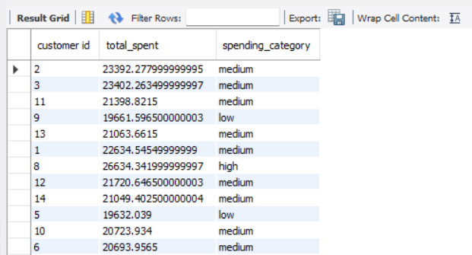
Task 3: Analyzing Customer Segmentation Based on Spending
select `customer id`, sum(`total`) as total_spent, case when sum(`total`) < 20000 then 'low' when sum(`total`) between 20000 and 25000 then 'medium' else 'high' end as spending_category from walmartsales group by `customer id`;

Slide 4
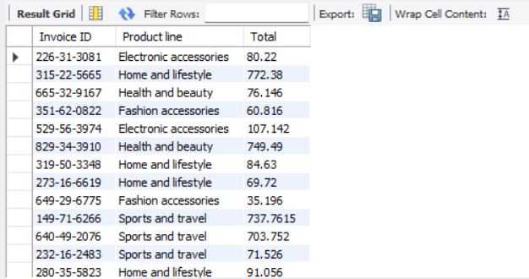
Task 4: Detecting Anomalies in Sales Transactions
select `Invoice ID`, `Product line`, `Total`from walmartsales where `Total` > ( select avg(`Total`) * 2 from walmartsales )or `Total` < ( select avg(`Total`) * 0.5 from walmartsales );

Slide 5
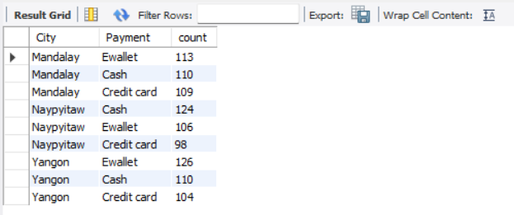
Task 5: Most Popular Payment Method by City
select `City`, `Payment`, count(*) as count from walmartsales group by `City`, `Payment` order by `City`, count desc;

Slide 6
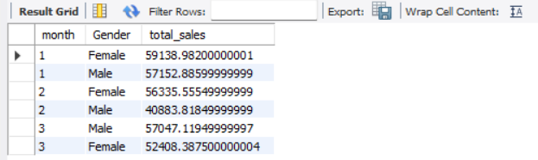
Task 6: Monthly Sales Distribution by Gender
select month(str_to_date(`Date`, '%d-%m-%Y')) as month, `Gender`, sum(`Total`) as total_sales from walmartsales group by month, `Gender`order by month, total_sales desc;

Slide 7
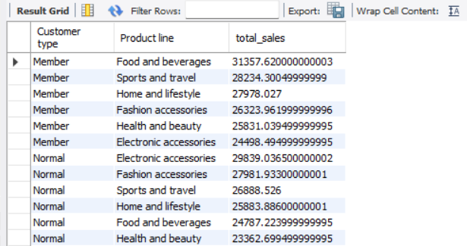
Task 7: Best Product Line by Customer Type
select `Customer type`, `Product line`, sum(`Total`) as total_sales from walmartsales group by `Customer type`, `Product line` order by `Customer type`, total_sales desc;

Slide 8
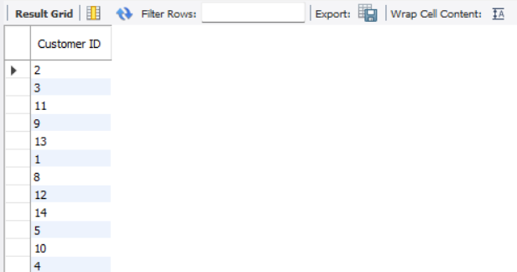
Task 8: Identifying Repeat Customers
select distinct a.`Customer ID` from walmartsales a join walmartsales b on a.`Customer ID` = b.`Customer ID` and a.`Invoice ID` <> b.`Invoice ID` where datediff(str_to_date(b.`Date`, '%d-%m-%Y'), str_to_date(a.`Date`, '%d-%m-%Y')) between 1 and 30;

Slide 9
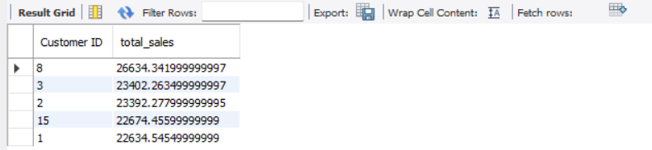
Task 9: Finding Top 5 Customers by Sales Volume
select `Customer ID`, sum(`Total`) as total_sales from walmartsales group by `Customer ID` order by total_sales desclimit 5;

Slide 10
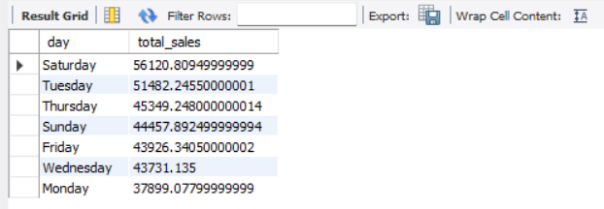
Task 10: Analyzing Sales Trends by Day of the Week
select dayname(str_to_date(`Date`, '%d-%m-%Y')) as day, sum(`Total`) as total_sales from walmartsales group by dayorder by total_sales desc;

Slide 11
VIDEO LINK
https://drive.google.com/file/d/1NRbcBGXSi8xOQK9qmskn6aLrU2xMVcoW/view?usp=sharing

